Slide 1


biblia kwa ujumla
A Presentation of The Bible…Basically Ministries International Inc. Fort Worth, Texas
BibleBasically.org
Designed by Dr. John Fryman, Texas, USA • BibleBasically.org
Taught by Dr. Rick Griffith, Singapore Bible College
All files in many languages for free download at BibleStudyDownloads.org
8.0.01.
©2003 TBBMI
04

Slide 2

waamuzi - Esta
7
UMBAJI
VURUGU
MME NA MKE WA 1
WAAMUZI
Dhambi ya 1
350
U
Injili ya 1
350
Jamii ya i
UTUKUFU
(1000 B.C.)
Uuwaji wa 1
GHarika / upinde
mnara
IBRAHAIMU
(2000 B.C.)
JAMII 3
U 7 KY
MWITO
AC
N_M_
I - I
Y - M
12
MATEKA
7 = 4 + 3
YUSUFU
VURUGU
UTUMWA
WaAMUZI
350
WATU 4
430
350
MUSA
(1500 B.C.)
(500 B.C.)
KUTOKA
K
S
KIMNYA
Sinai
M - C - C
Kadesh Barnea
YESU
40
40
LC
5 Sermons
Y
JOSHUA
Yeriko/Ai
Kugawa nchi
4
15

Slide 3

Josh. 14:5; 24:29; Judg. 17:6
Mabadililo ya eneo...
Nchi ya nyakuliwa.
Nchi unagawanywa.
Yoshua afariki.
Kukawa na ukosefu wa kiongozi
02
4

Slide 4
?
7
swali:
je unafikiria nini kilitendeka wakati….
03

Slide 5
Waam. 17:6
7
ASHER
NAPHTALI
Bahari kuu
ZEBULON
Bahari ya Galilaya
Ml. Tabori
Ml. Carmel
ISSACHAR
Mt. Gilboa
“Kila mtu alifanya hayo aliyoyaona kuwa ni mema machoni pake mwenyewe.”
MANASSE
MANASSE
YOSHUA
EPHRAIM
Jericho/Ai
KUGAWA NCHI
DANI
BENJAMIN
GAD
YUDA
Hebron
Bahari ya chumvi
REUBEN
SIMEONI..
WALAWI waliishi katika vijiji.
04

Slide 6
Waamuzi. 17:6
7
ASHER
NAPHTALI
The Great Sea
ZEBULON
Sea of Galilee
Mt. Tabor
Mt. Carmel
ISSACHAR
“Kila mtu alifanya hayo aliyoyaona kuwa ni mema machoni pake mwenyewe.”.”
Mt. Gilboa
MANASSEH
MANASSEH
YOSHUA
EPHRAIM
YERICHO/AI
DAN
Nchi ya gawannywa
BENJAMIN
GAD
Vurugu!
YUDA
Hebron
Dead Sea
REUBEN
SIMEON
LEVI: Only towns to live in.
Handbook pg. 31-32
05

Slide 7
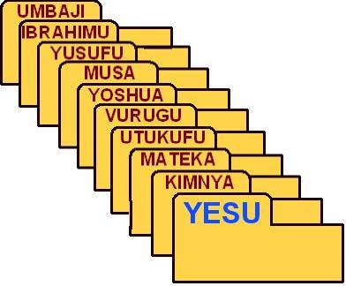
WAAMUZI & RUTHU
V U M
Handbook pg. 31-32
7.2.03d.
©2003 TBBMI
06

Slide 8
Judg. 17:6
7
VURUGU
Wa KWANZA
kwa
JAMII 3
ni:
VURUGU
Watu hawakutambua uongozi wa serikali yoyote.
350
V U M
Handbook pg. 31-32
07

Slide 9
Judg. 2:16-17
7
VURUGU
WAAMUZI
VURUGU
WAAMUZI
350
WAKATI WA KUANGUKA KWA TAIFA
Handbook pg. 31-32
08
1

Slide 10
Waam. 2:16-17
7
Othniel
Ehud
Shamgar
Deborah & Barak
Jair
Abimelech
Tola
Gideon
Jephthah
Ibzan
Elon
Abdon
SamsonI
Eli
Samuel
VURUGU
Deborah & Barak
WAAMUZI
Kulingana na mbinu tafauti za kufanya hesabu kuna kati ya WAAMUZI 13 na 15 WA ISRAELII YA KALE
Gideon
VURUGU
WAAMUZI
350
Samson
Handbook pg. 31-32
1
09

Slide 11
1 Sam. 7:15
7
LAKINI KATi YA
WAAMUZI WENGI WA ISRAELII...
WA KWANZA NA WA MWISHO,
YULE “MWENYE MABADILIKO MAKUU ,” NI
SAMUELI
VURUGU
WAAMUZI
350
Handbook pg. 31-32
©2003 TBBMI
10

Slide 12
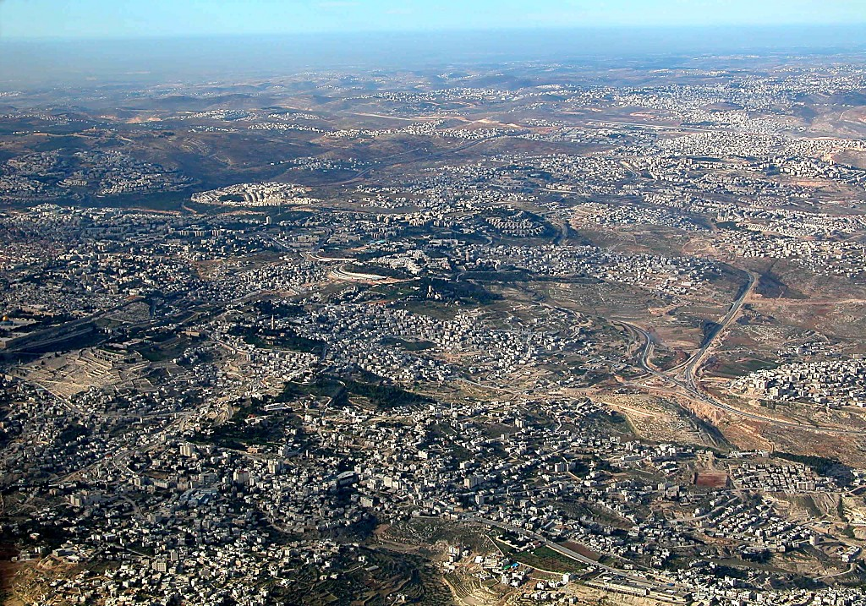
East Jerusalem and Mt of Olives aerial from s
1 Sam. 7:15
7
Nebi Samwil (karibu na Rama)
BUT OF THE
MANY JUDGES
OF
ISRAELI...
Samueli: Nabii na mwamuzi; mahali pa kuishi kwake na kuzaliwa kwake kazkazini mwa Yerusalemu
HEKALU LA MLIMA
THE LAST AND GREATEST,
THE “HINGE CHARACTER,” WAS...
SAMUEL
VURUGU
Ml wa mizeituni
Judges
Bethany
350
Dome of the Rock
Njia ya kuelekea Yeriko
Handbook pg. 31-32
1
11
©2003 TBBMI
7.2.03d.

Slide 13
1 Sam. 8:4-9
1 Sam. 8:10-19
7
VURUGU
WAAMUZI
350
VURUGU
WAAMUZI
“TWATAKA MFALME!”
350
350
“JE MNA UHAKIKA MNATAKA KUFANYA HIVYO?”
Handbook pg. 31-32
12
2

Slide 14
1 Sam. 9:17
7
SAMSON
OF THE
13 JUDGES
OF
ISRAELI...
DEBORAH
GIDEON
THE LAST AND GREATEST,
THE “HINGE CHARACTER,” WAS...
VURUGU
UTUKUFU
SAMUELI
Handbook pg. 31-32
13
1

Slide 15
U
V M
“UTUKUFU”
14
2

Slide 16
Genesis - 1 Samuel 8:22a
7
UMBAJI
VURUGU
MME NA MKE WA 1
WAAMUZI
Dhambi ya 1
350
U
Injili ya 1
350
Jamii ya i
UTUKUFU
(1000 B.C.)
Uuwaji wa 1
GHarika / upinde
mnara
IBRAHAIMU
(2000 B.C.)
JAMII 3
U 7 KY
MWITO
AC
N_M_
I - I
Y - M
12
MATEKA
7 = 4 + 3
YUSUFU
VURUGU
UTUMWA
WaAMUZI
350
430
350
WATU 4
MUSA
(1500 B.C.)
(500 B.C.)
KUTOKA
K
S
KIMNYA
Sinai
M - C - C
Kadesh Barnea
YESU
40
40
LC
5 Sermons
Y
JOSHUA
Yeriko/Ai
Kugawa nchi
4
15

Slide 17
MAKISIYO YA NYAKATI
IBRAHIMU-YUSUFU 2000 B.C.
MUSA- YOSHUA 1500 B.C.
VURUGU-UTUKUFU 1000 B.C.
16

Slide 18
1 Sam. 9:1-2 WAFALME 25:21
V U M
Handbook pg. 32-37
17
©2003 TBBMI
7.2.03d.

Slide 19
KUANDAA
JUKWAA
BM
N(A)
H
MUNGANO ISRAELII yakuwa na utukufu wa kimataifa na kuongoza kwa mali na uwezo!
SG
K
ER
B
Y
MN
C
M
KB
U
MS
GU
BS
Handbook pg. 32-37
1
18

Slide 20

1 Sam. 9:1
7
UTUKUFU
ca. 1000 B.C.
Wa PILI
kwa
ZILE JAMII 3
ni:
UTUKUFU
V U M
Handbook pg. 32-37
1
19

Slide 21
1 Sam. 15:1; 2 Sam. 2:4; 1 WAF 1:43
7
UTUKUFU
ca. 1000 B.C.
S - D - S
SAULI
VUM
DAUDI
UTUKUFU
S - D - S
SULEIMANI
Handbook pg. 32-37
20
4

Slide 22
1 Sam. 16:13-14
7
UTUKUFU
ca. 1000 B.C.
S - D - S
A R C
Mflame Sauli: mtu wa mawazo/ majuto!
Samueli aitwa kupaka mrithi wa Sauli: kijana Daudi wa Bethlehemu..
UTUKUFU
S - D - S
Handbook pg. 32-37
21

Slide 23
1 Sam. 16:1
7
UTUKUFU
ca. 1000 B.C.
S - D - S
V U M
UTUKUFU
S - D - S
Wachungaji wakilinda kondoo kule Bethelehemu
Handbook pg. 32-37
22
1

Slide 24
7
UTUKUFU
ca. 1000 B.C.
DC
Agano la kidaudi
S - D - S
2 Sam 7: 4-16
1 Kum 17:3-15
V U M
UTUKUFU
S - D - S
Handbook pg. 32-37
23
1

Slide 25
7
AGANO LA KIDAUDI
AHADI ZAKE TATU
2 Samueli 7
¹⁶ na nyumba yako na ufalme wako vitathibithishwa milele mbele yako;nacho kiti chako kitafanywa imara milele.
nyumba
ufalme
milele
UTUKUFU
S - D - S
kiti
milele
Handbook pg. 32-37
5
24

Slide 26

Agano la kiibrahimu
Mwan 12:1-3
NCHI
MBEGU
BARAKA
nchi
Daudi
Kum
30:1-10
2 nya
7:4-16
Handbook pg. 32-37
25
Notes:
So, then…the DAVIDIC COVENANT becomes an amplification of the Seed portion of the ABRAHAMIC COVENANT...the second part of the LAND, the SEED, and the BLESSING formula. This DAVIDIC promise is the SEED portion, the Davidic Covenant. Let's take a look at David's Jerusalem.

Slide 27
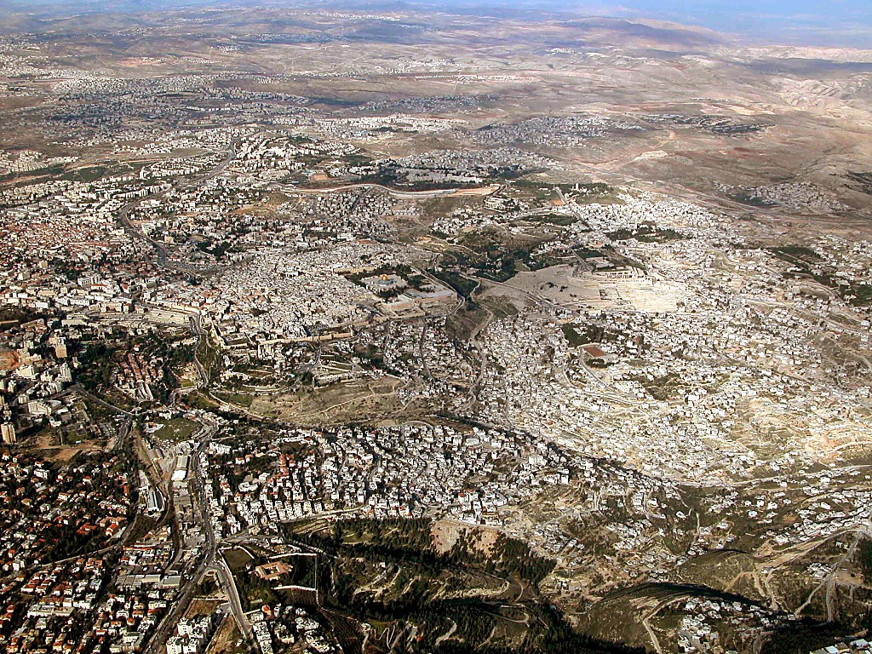
Jerusalem area aerial from KUSINI
2 Sam. 24:18-24; 2 Chron. 3:1
Yerusalemu: kutoka kusini kuelekea mlima wa hekalu
26
©2003 TBBMI
7.2.03d.

Slide 28

Old City aerial from KASKAZI
2 Sam. 24:18-24; 2 Nya. 3:1
Mlima wa hekalu: Yerusalem Global Focal Point
27
©2003 TBBMI
7.2.03d.

Slide 29
2 Sam. 24:18-24; 2 Nya. 3:1
Kiwanja cha kupuria cha Arauna…
Daudi alikinunua…
Kujenga hekalu ya Bwana!
Katika kilele cha Mlima Moriah!
28
5
©2003 TBBMI
7.2.03d.

Slide 30

1 Wafalme 5:5
Mfalme Daudi alifanya mpango.
UTUKUFU
S - D - S
Lakini mwanawe Suleimani aliujenga
Handbook pg. 32-37
29
1

Slide 31
1 wafalme 5:5
UTUKUFU
S - D - S
Hekalu ya “kwanza” ya ISRAELIi
Handbook pg. 32-37
30

Slide 32
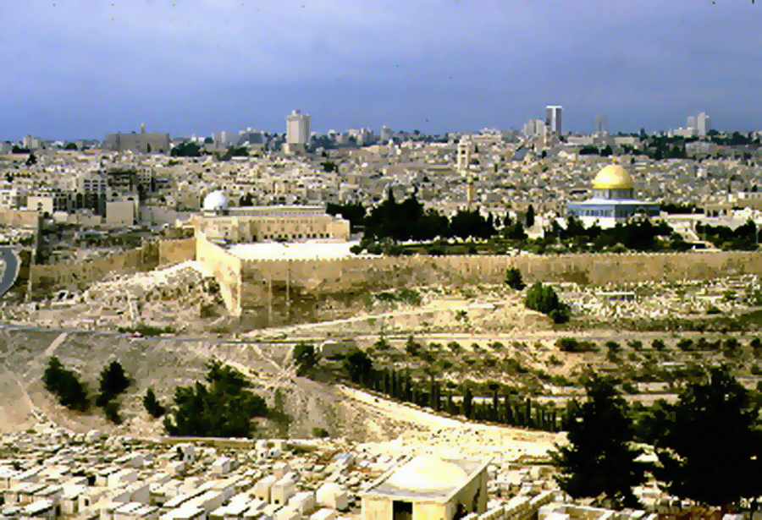
1 Wafalme 6:14-38
Mlima wa Hekalu la Yerusalemu leo
Sehemu ambapo Ibrahimu anglimtoa Iskaka kama thabhu
Je walifanya ujenzi kwa njia gani?
Bila mashine vya umeme!
UTUKUFU
S - D - S
wala makomputa,
kwa mikono peke!
Handbook pg. 32-37
Handbook pg. 32-37
31
5

Slide 33
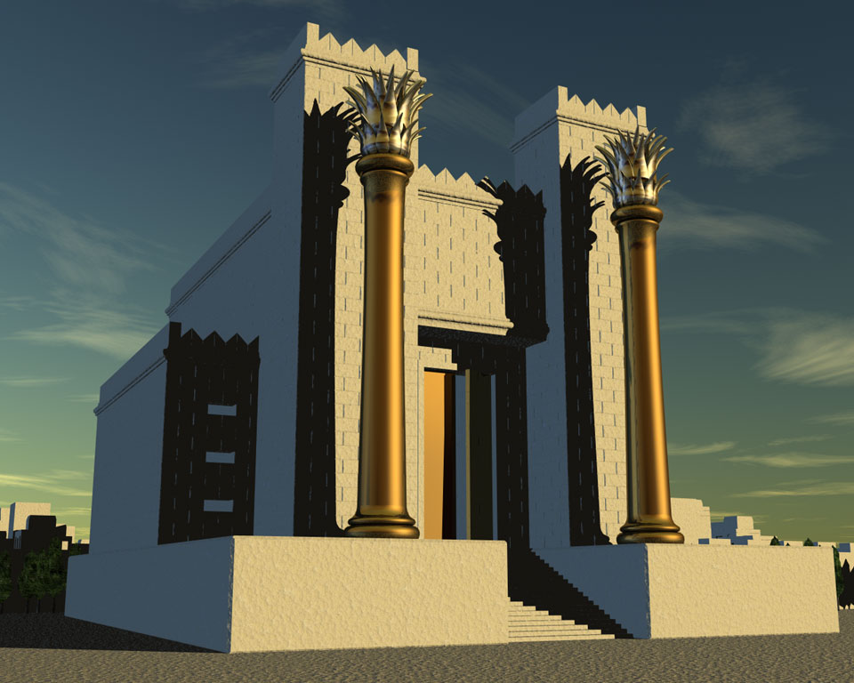
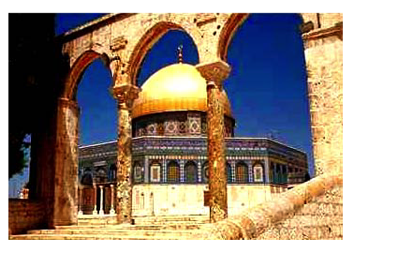
1 Wafalme 6:14-38; Matt. 21:12-23
Sehemu ambapo Ibrahimu anglimtoa Iskaka kama thabhu
Mlima wa Hekalu la Yerusalemu leo
Mlima Moria … Mllima Ziuni
Wakaezeka mijengo hizi za kiajabu
Kuta wa magharibi “ kuta ya masikitiko”
UTUKUFU
S - D - S
Hekalu ya pili ya Yerusalemu
Hekalu ya kwanza kujengwa na Suleimani
Leo ni jengo la mwamba la waislamu
Handbook pg. 32-37
32
6

Slide 34
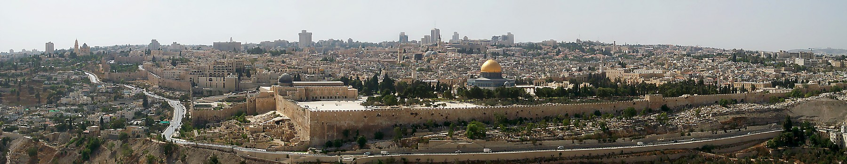
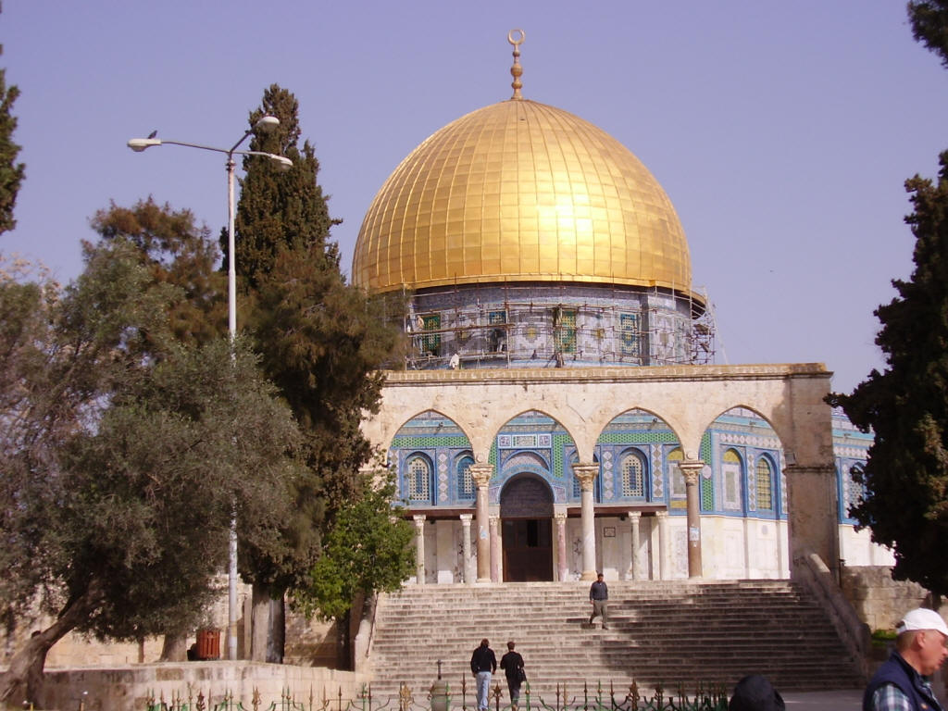
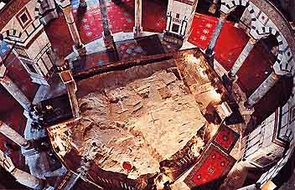
Jerusalem's Temple Mount Today
Inside the Dome of the Rock
Dome of the Rock on The Temple Mount
Handbook pg. 32-37
32a
1
Notes:
Here is the octagonal shrine as you would approach it from the south, leaving the famed Al Aqsa Mosque, also held by Islam to be one of its most holy sites.
//// Inside the Dome, looking downward, is “The Rock” from which Mohammed is said to have gone to the “Seventh Heaven” on a ladder. The building is covered throughout with hundreds of colorful carpets, its ancient roof supported by a multitude of stone columns.

Slide 35
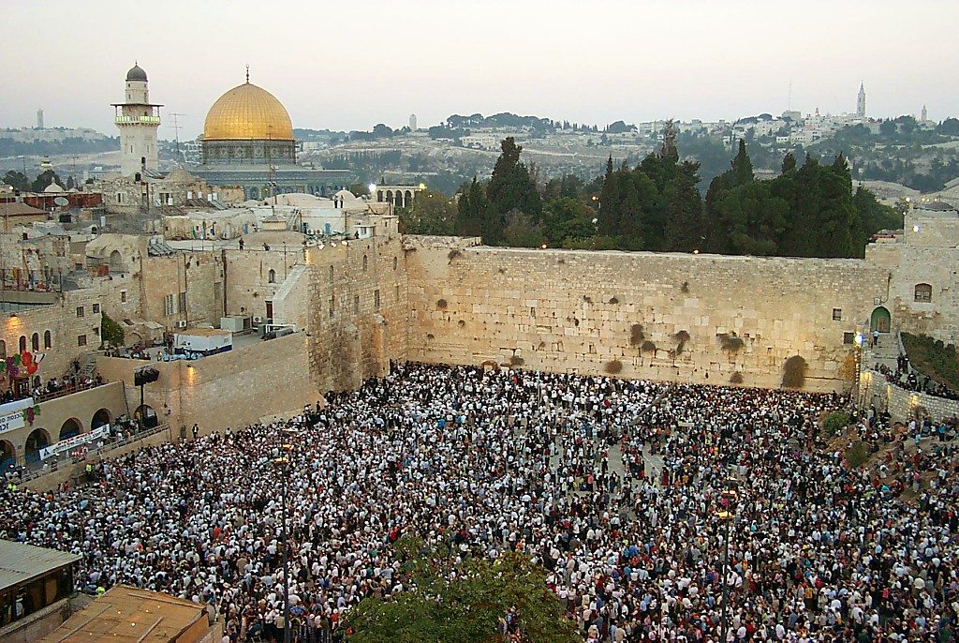
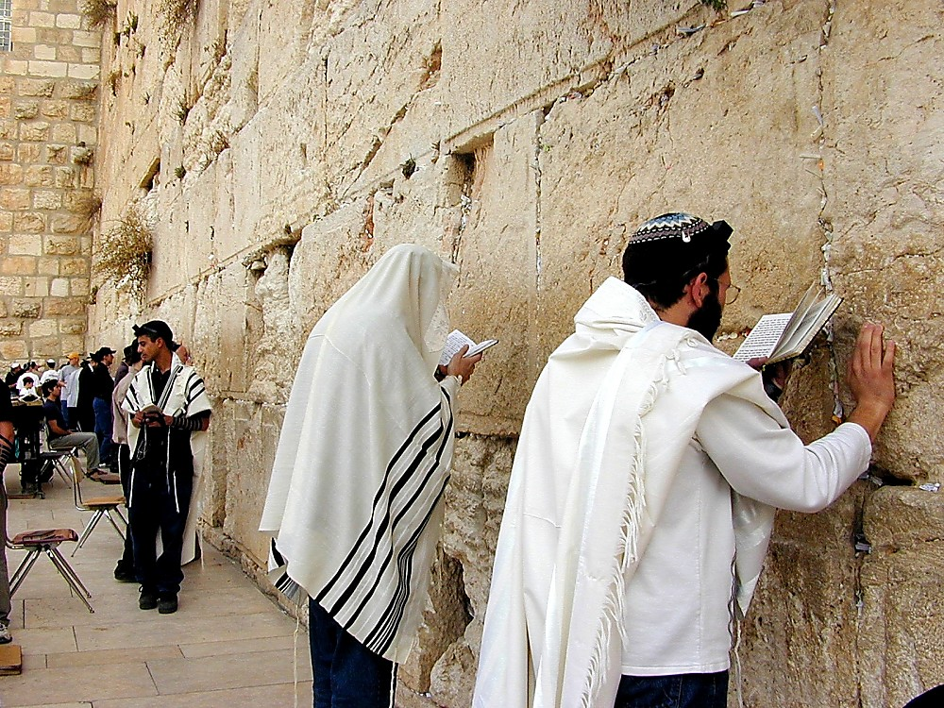
1 Wafalme 6:14-38
UTUKUFU
S - D - S
Ukuta wa magaribi “ukuta wa masikitiko”
Handbook pg. 32-37
1
33

Slide 36

1 Wafalme 6:14-38
UTUKUFU
S - D - S
Handbook pg. 32-37
1
34

Slide 37

1 Wafalme 6:14-38; Matt. 21:12-23
Hekalu ya mlima wa Yerusalemu wa leo
Kilele cha dunia nzima
Handbook pg. 32-37
35

Slide 38
7
UTUKUFU
ca. 1000 B.C.
S - D - S
DC
2 Sam 7: 4-16
1 Nya 17:3-15
V U M
UTUKUFU
S - D - S
SULEIMANI: MAWAZO MAKUBWA!
JAMBO KUU: MADENI YAFAA KULIPIWA
Handbook pg. 32-37
36
6

Slide 39
1 Wafalme 9, 10, 11
7
UTUKUFU
ca. 1000 B.C.
Mijengo!
Malipo ya kodi!
Kukosekana kwa mali!
Kuabudu sanamu!
S - D - S
DC
2 Sam 7: 4-16
1 Nya 17:3-15
V U M
UTUKUFU
S - D - S
Handbook pg. 32-37
37
4

Slide 40
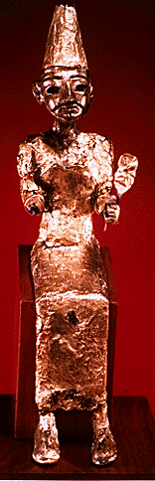
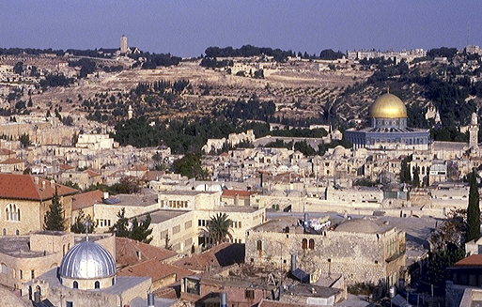
1 Wafalme 11:4-8
7
UTUKUFU
Mlima wa mizeituni
ca. 1000 B.C.
S - D - S
DC
2 Sam 7: 4-16
1 Nya 17:3-15
V U M
Mlima wa Hekalu
UTUKUFU
S - D - S
Kuabudu sanamu!
Handbook pg. 32-37
38
4

Slide 41
1 Wafalme 12:25-14:20; 14:21-31
7
UTUKUFU
ca. 1000 B.C.
S - D - S
DC
< MTENGANO >>
KASKAZI KUSINI
2 Sam 7: 4-16
1 Nya 17:3-15
V U M
ISRAELI YUDA
10 2
UTUKUFU
S - D - S
••• MTENGANO •••
KASKAZI KUSINI
ISRAELI
YUDA
10 2
Handbook pg. 32-37
39
4

Slide 42
1 Wafalme 12:25-14:20; 14:21-31
7
UFALME WA KASKAZI
ISRAELI
MAKABILA 10
SAMARIA
UTUKUFU
S - D - S
••• MTENGANO •••
YERUSALEMU
KASKAZINI KUSINI
ISRAELII
YUDAH
MAKABILA 2
10 2
UFALME WA KUSINI
YUDAH
Handbook pg. 32-37
40
1

Slide 43
1 Wafalme 17-22; Isaiah through Malachi
7
UTUKUU
ca. 1000 B.C.
S - D - S
DC
<< MTENGANO >>
KASKAZINI KUSINI
2 Sam 7: 4-16
1 Nya 17:3-15
V U M
ISRAELII YUDAH
10 2
UTUKUFU
MANBAII
S - D - S
•• MTENGANO •
KASKAZI KUSINI
YUDA
ISRAELII
10 2
MANABII
Handbook pg. 32-37
41

Slide 44
Isaia - Malachi
7
YONA
MIKA
UTUKUFU
ca. 1000 B.C.
EZEKIEL
S - D - S
ZEPHANIAH
DANIELI
<< MTENANO >>
ZECHARAIA
KASKAZI KUSINI
YEREMIA
ISRAELII YUDA
AMOSI
HABAKUKI
YOELI
10 2
MANABII
UTUKUFU
S - D - S
HAGGAI
••• MTENGANO •••
KASKAZI KUSINI
OBADIA
ISRAELI
YUDA
ELISHA
10 2
MANABII
HOSEA
ELIJAH
ISAYA
NAHUM
MALACHI
Handbook pg. 32-37
42

Slide 45
7
UTUKUFU
ca. 1000 B.C.
S - D - S
DC
<< MTENGANO >>
KASKAZI KUSINI
2 Sam 7: 4-16
1 Nya 17:3-15
V U M
ISRAELI YUDA
10 2
NC
UTUKUFU
MANABII
Agano jipya
S - D - S
••• MTENGANO •••
KASKAZI KUSINI
ISRAELII
YUDA
Yer 31: 31-33
10 2
MANABII
Handbook pg. 32-37
43

Slide 46
7
Yeremiah 31
AGANO JIPYA
³¹ “Analia siku zinakuja,” asema BWANA, “nitakapofanya agano jipya
na nyumba ya ISRAELIi na nyumba
ya Yuda.
UTUKUFU
na nyumba ya ISRAELIi na nyumba
ya Yuda
S - D - S
••• MTENGANO •••
KUSINI YUDA
ISRAELI
YUDA
10 2
MANABII
MASIA ANAHIDIWA
Handbook pg. 32-37
44
3

Slide 47
Agano la Kiibrahimu
Mwan. 12: 1-3
NCHI MBEGU BARAKA
UTUKUFU
S - D - S
••• MTENGANO •••
KASKAZI kusini
nchi kidaudi jipya
ISRAELI
YUDA
10 2
MANABII
Kum 30: 1-10
2 Sam 7:4-16
1 Nya 17:3-15
Yer 31: 31-33
Handbook pg. 32-37
45
5

Slide 48
1 Wafalme 12 - 2 Wafalme 24
7
UTUKUFU
ca. 1000 B.C.
S - D - S
DC
<< MTENGANO >>
KASKAZI KUSINI
2 Sam 7: 4-16
1 Chron 17:3-15
VU M
ISRAELII YUDAH
10 2
NC
UTUKUFU
MANABII
S - D - S
••• MTENGANO •••
KASKAZI KUSINI
20-Y 20-R
ISRAELI
YUDA
10 2
Kaskazi: Yeroboamu
Kusini: Rehoboamu
MANABII
20-J 20-R
WAFALME WOTE WAOVU
WAFAME WACHACHE WAZURI
Handbook pg. 32-37
46
3

Slide 49
2 Wafalme 17:6
7
UTUKUFU
ca. 1000 B.C.
S - D - S
DC
<<<< MTENGANO >>>>
KASKAZI KUSINI
2 Sam 7: 4-16
1 Nya 17:3-15
V UM
ISRAELI YUDA
10 2
nC
UTUKUFU
MANABII
S - D - S
••• MTENGANO •••
KASKAZI KUSINI
20-J 20-R
ISRAELI
YUDA
Yer 31: 31-33
10 2
200
MANABII
20-J 20-R
200
ASHURU
ASHURU
Handbook pg. 32-37
47

Slide 50
2 Wafalme 17:6
KUANDAA
JUKWAA
MS
N(A)
H
SG
C
ER
B
J
MN
UTUKUFU
DS
S - D - S
••• MTENGANO •••
E
KASKAZI KUSINI
UFALME WA KASKAZINI
ISRAELI (722 B.C.)
MSAFARA MKUU WA KIYAHUDI
ISRAELI
YUDA
KB
U
10 2
MANABII
20-J 20-R
200
ASHURU
MS
PG
RS
Handbook pg. 32-37
48
4

Slide 51
KUANDAA
JUKWAA
BM
Hata hivyo ufalme wa KUSINI?
N(A)
H
SG
C
MH
B
Y
MN
UTUKUFU
DS
S - D - S
BABELI YA NYAKUA ASHURU!
••• MTENGANO •••
M
KASKAZI KUSINI
ISRAELI
YUDA
KB
U
10 2
MANABII
20-J 20-R
200
ASHURU
MS
BG
BS
Handbook pg. 32-37
49
2

Slide 52
2 Wafalme 25:21
7
UTUKUFU
ca. 1000 B.C.
S - D - S
DC
<< MTENGANO >>
KASKAZI KUSINI
2 Sam 7: 4-16
1 Nya 17:3-15
VUM
ISRAELI YUDA
10 2
NC
UTUKUFU
MANABII
S - D - S
••• MTENGANO •••
KASKAZI K USINI
20-J 20-R
ISRAELI
YUDA
Yer 31: 31-33
10 2
200
350
MANABII
20-J 20-R
350
200
ASHURU
BABELI
ASHURU
BABELI
Handbook pg. 32-37
50

Slide 53
2 Wafakme 25: 1-21
KUANDAA
JUKWAA
BM
N(A)
H
BG
C
ER
B
J
MN
UTUKUFU
BC
S - D - S
••• MTENGANO •••
M
KASKAZI KUSINI
ISRAELI
YUDA
KB
U
10 2
MANABII
UFALME WA KUSINI
YUDA (586 B.C.)
MATEKA WA KIBABELI
20-J 20-R
350
200
BABELI
ASHURU
MS
PG
RS
Handbook pg. 32-37
51
2

Slide 54
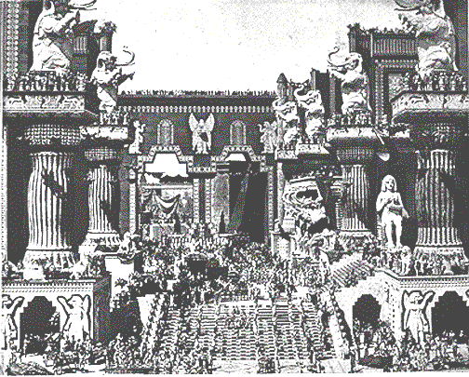
2 Wafalme 25: 1-21
UTUKUFU
S - D - S
••• MTENGANO •••
KASKAZI KUSINI
ISRAELI
YUDA
10 2
MANABII
The Ancient City of BABELI
From the early motion picture
“Intolerance”
20-J 20-R
350
200
B ABELI
ASHURU
Handbook pg. 32-37
52

Slide 55
MWANZO - NEHEMIAH
7
UMBAJI
VURUGU
VURUGU
MME NA MKE WA 1
WAAMUZI
Dhambi ya 1
WAAMUZI
350
350
350
U
Injili ya 1
350
Jamii ya i
UTUKUFU
(1000 B.C.)
Uuwaji wa 1
UTUKUFU
GHarika / upinde
S - D - S
mnara
MTENGANO
KASKAZI KUSINI
IBRAHAIMU
(2000 B.C.)
YUDA
ISRAELI
JAMII 3
MWITO
AC
10 2
U 7 KY
N_M_
MANABII
I - I
20-J 20-R
Y - M
200 350
12
ASHURU BABELI
MATEKA
7 = 4 + 3
YUSUFU
UTUKUFU
UTUMWA
S - D - S
430
••• MTENGANO •••
WATU 4
KASKAZI KUSINI
MUSA
(1500 B.C.)
ISRAELI
YUDA
K
KIMNYA
(500 B.C.)
10 2
KUTOKA
S
MANABII
Sinai
20-J 20-R
M - C - C
200
Kadesh Barnea
YESU
ASHURU
BABELI
40
40
LC
5 Sermons
Y
JOSHUA
Yeriko/Ai
Kugawa nchi
4
15

Slide 56
7
M
V U
“MATEKA”
Handbook pg. 37-38
54
1

Slide 57
2 Wafalme 25:21 hadi Ezra 1:3
V U M
Handbook pg. 37-38
7.2.03d.
©2003 TBBMI
55

Slide 58
MAKISIYO YA NYAKATI
IBRAHIMU- YUSUFU 2000 B.C.
MUSA-YOSHUA 1500 B.C.
VURUGU-UTUKUFU 1000 B.C.
MATEKA-KIMNYA 500 B.C.
56

Slide 59
KUANDAA
UKWAA
Isaia 9:6-7
Kufikia tamati
MS
N(A)
H
SG
C
mh
B
J
MN
DS
Yuda inahifadhiwa
M
Kwa nini?
U
KB
MS
Kwa sababu> hapo kale masia alitabiriwa kuzaliwa kotoka Yuda
PG
RS
Handbook pg. 37-38
57
8

Slide 60
2 Wafalme 25:21
7
MATEKA
Wa Tatu
kwa
Zile jamii
tatu
ni
MATEKA
V U M
Handbook pg. 37-38
58

Slide 61
Daniel 1
Jiji la kale la BABELI
MATEKA
Mto wa Hidekeli
Shamba la kuniniginia la BABELI
Handbook pg. 37-38
59

Slide 62
7
MATEKA
JUKWAA LA IGIZO
Handbook pg. 37-38
60

Slide 63
Yer. 29:10; Ezra 3:8; Neh. 2:5-6
7
MATEKA
MIAKA 70
SAFARI 3
V U M
MATEKA
MIAKA 70
SAFARI 3
“WAYAHUDI
“WAYAHUDI”
“SINAGOGI”
“SINAGOGI”
Handbook pg. 37-38
61
3

Slide 64
7
SAFARI 3
MATEKA
MIAKA 70
SAFARI 3
JUKWAA LA IGIZO
Handbook pg. 37-38
62

Slide 65
Ezra 1-2
7
MATEKA
MIAKA 70
SAFARI 3
V U M
MIAKA 100 / 50,000
MATEKA
MIAKA 70
SAFARI 3
MIAKA100 / 50,000
Handbook pg. 37-38
63

Slide 66
Ezra 1:4
50,000 WALIRUDI!
LAKINI WENGI WALIBAKI NYUMA KUGHARIMU SAFRARI
MATEKA
MIAKA 70
SAFARI 3
MIAKA100 / 50,000
Handbook pg. 37-38
64
1

Slide 67
Yer. 29:10; Ezra 3:8; Neh. 2:5-6
7
ZERUBBABELI
MATEKA
EZRA
MIAKA 70
SAFARI 3
MIAKA100 / 50,000
Z - E - N
MATEKA
NEHEMIA
MIAKA 70
SAFARI 3
MIAKA100 / 50,000
Z - E - N
Handbook pg. 37-38
65
4

Slide 68
Yer. 29:10; Ezra 3:8; Neh. 2:5-6
7
ZERUBBABELI…arudi kuanza kujenga upya hekalu
ZERUBBABEL
MATEKA
EZRA…arudi kufundisha amri za Mungu.
EZRA
MIAKA 70
Z-E-N
3 TREKS
MIAKA100 / 50,000
Z - E - N
WAJUMBE WATATU MAKUHANI
MATEKA
NEHEMIA…arudi kama kiogozi wa agano la kale kujenga upya milango na kuta za jiji.
MIAKA 70
NEHEMIA
SAFARI 3
MIAKA100 / 50,000
Z - E - N
Handbook pg. 37-38
66
3

Slide 69
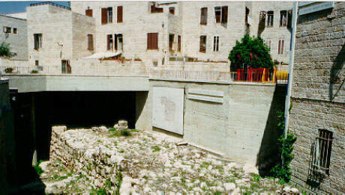
Neh. 3:8
7
7
Yerusalemu: kuchimbua mabaki za kuta za Nehemiah
MATEKA
MIAKA 70
SAFARI 3
MIAKA100 / 50,000
Z - E - N
Handbook pg. 37-38
67

Slide 70
KUANDAA
JUKWAA
MS
ISRAELI
N(A)
H
YUDA
SG
C
MH
B
MATEKA
Y
MN
MIAKA 70
SAFARI 3
DS
MIAKA100 / 50,000
Z - E - N
E
MIAKA100 / 50,000
Katika mwisho wa agano la kale ISRAELI ikatawanyika; YUDA ikarudishwa.
U
Katika mwisho wa agano la kale ISRAELI ikatawanyika; YUDA ikarudishwa
KB
MS
PG
Masia aahidiwa “ulipowadia utimilifu wa wakati.”
Masia aahidiwa “ulipowadia utimilifu wa wakati.”
Masia aahidiwa “ulipowadia utimilifu wa wakati.”
RS
Handbook pg. 37-38
3
68

Slide 71
waamuzi - Esta
7
UMBAJI
VURUGU
MME NA MKE WA 1
WAAMUZI
Dhambi ya 1
WAAMUZI
350
350
Injili ya 1
350
U
350
Jamii ya i
UTUKUFU
(1000 B.C.)
Uuwaji wa 1
UTUKUFU
GHarika / upinde
S - D - S
mnara
••• MTENGANO •••
KASKAZI KUSINI
(2000 B.C.)
YUDA
ISRAELI
IBRAHAIMU
JAMII 3
MWITO
AC
10 2
U 7 KY
N_M_
MANABII
I - I
20-J 20-R
Y - M
200 350
12
ASHURU BABELI
MATEKA
MATEKA
7 = 4 + 3
YUSUFU
MIAKA 70
MATEKA
UTUMWA
SAFARI 3
MIAKA 70
430
WATU 4
MIAKA100 / 50,000
SAFARI 3
Z - E - N
MIAKA100 / 50,000
(1500 B.C.)
MIAKA100 / 50,000
MUSA
(500 B.C.)
Z - E - N
K
S
KIMNYA
(500 B.C.)
KUTOKA
Sinai
M - C - C
Kadesh Barnea
YESU
40
40
LC
5 Sermons
Y
JOSHUA
Yeriko/Ai
Kugawa nchi
4
15

Slide 72


Biblia Kwa Ujumla link at BibleStudyDownloads.org
Get this presentation for free!
Notes:
The Bible…Basically (bb)

Slide 73
7.2.03d.
70

